Slide 1
APPROACHES TO COMPUTE INFRASTRUCTURE - EC2, VPC, AND LOAD BALANCING
Section 1
Notes:
[Mandatory Slide] This would be the introduction slide of the topic that you are covering in this section.
When this slide plays, you could talk about the main aim that we’d be covering in this section.

Slide 2
Exploring EC2 instances
Secure and Resizable Compute Capacity in the Cloud
Notes:
[Mandatory Slide] This would be the introduction slide of the topic that you are covering in this subsection.
When this slide plays, you could talk about the main aim that we’d be covering in this video.

Slide 3




What is Amazon EC2?
A web service that provides secure, resizable compute capacity in the cloud
Allows you to obtain and configure capacity with minimal friction
Provides complete control of computing resources
Run on Amazon’s proven computing environment
Notes:
This slide, like mentioned above is for multiple pointers. The information above covers the types of information that can be used in this slide

Slide 4


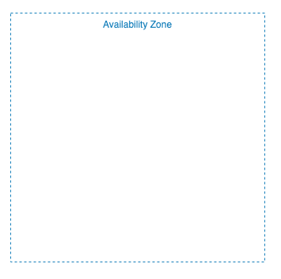
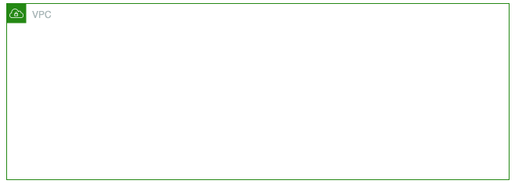

EC2 Ecosystem
EC2 runs within the AWS global infrastructure
Notes:
This slide, like mentioned above is for multiple pointers. The information above covers the types of information that can be used in this slide

Slide 5
Reliable and Scalable Infrastructure On Demand
Increase or decrease your compute capacity within minutes
Amazon commits to 99.99% availability for all EC2 instances
EC2 instances run in AWS Availability Zones, which in turn run in Regions
Select from over 250 instance types
Optimize the cost and performance of you workloads
Select processor, storage and networking options, operating system, and purchase model
Notes:
This slide, like mentioned above is for multiple pointers. The information above covers the types of information that can be used in this slide

Slide 6
Name of the Next Video
Next Video
Notes:
[Mandatory Slide]
Here the name of the next video needs to be mentioned. The narration as you guessed it would be just letting the viewer know exactly where we are at and what we’d be taking over next! ☺

